Slide 1

Winter Presentation
The Smart Jacket

Slide 2
Architecture Diagram

Slide 3
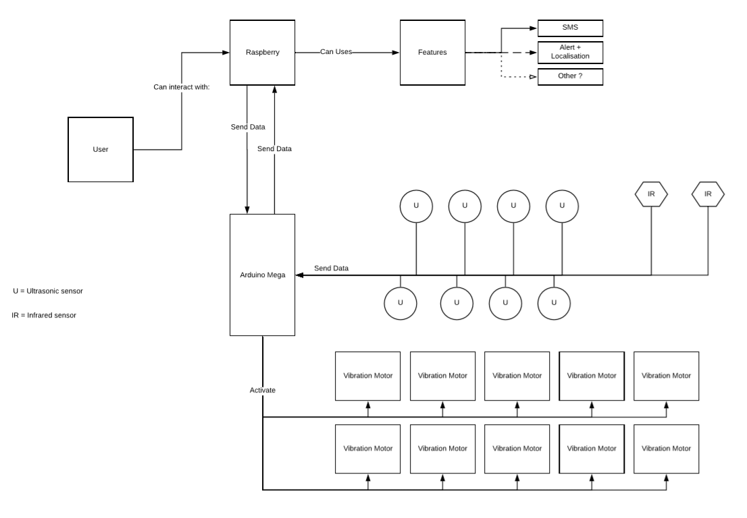

Slide 4
Detection Process
Detect an obstacle
Validate the detection
Send data
Receive Data
Data received properly
Activate the corresponding motor

Slide 5
Diagram

Slide 6
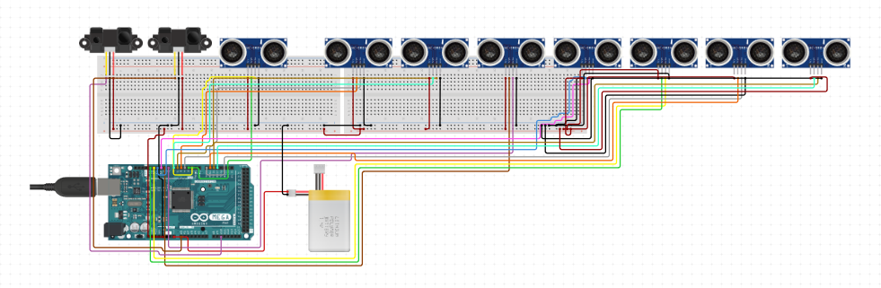

Slide 7
Explanation

Slide 8
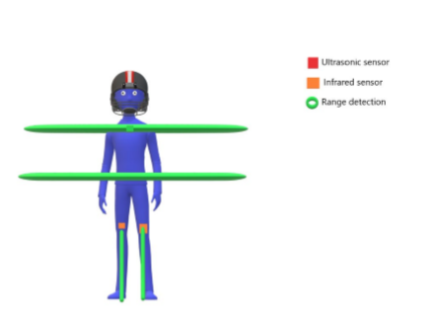

Slide 9
Timeline

Slide 10
